Slide 1
The UCSF Population Health Data Initiative: New Research Resources
Rita Hamad, MD, PhD
PHDI Faculty Lead for Research Resources
Philip R. Lee Institute for Health Policy Studies
Department of Family & Community Medicine

Slide 2
The Population Health Data Initiative
HELP!
PHDI supports efforts to provide data and other research resources for population health, health equity, and health services research at UCSF.

Slide 3
Cataloguing data resources
Facilitating data access and licensing
Enhancing computational resources
Notes:
Main domains that PHDI currently supports

Slide 4
A Guide to Population Health Data
The Problem: Population health, health equity, and health services datasets are hard to find!
The Team: Collaboration between PHDI and the UCSF Library
Notes:
Worked with Alice Fishman to pull the datasets from the old CELDAC registry

Slide 5
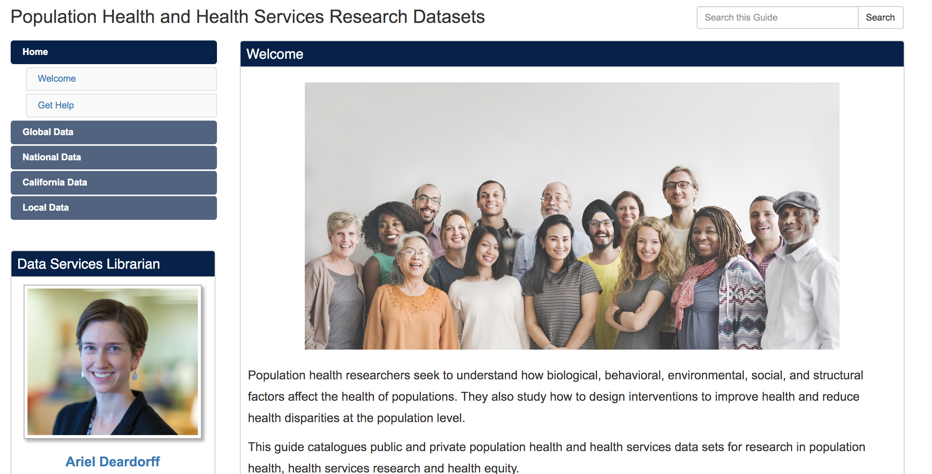
Introducing the Data Guide
Notes:
Guide lists over 100 population health resources from global, national and local data purveyors.
Many of whom were included in the old CELDAC registry

Slide 6
Notes:
Covers all kinds of data including administrative, demographic, epidemiology, surveys, etc
Identifies if they are free or require a fee (with the icon)
If we have a copy of the data there is a link to access it via a CTSI consultation

Slide 7
Want help accessing/using data?
Check out the guide at guides.ucsf.edu/pophealthdata
To learn more about study design, data selection, or data acquisition – request a CTSI population health data consult
To suggest a dataset to add to the guide, or get help managing or analyzing data – request a library data science consultation

Slide 8
A Guide to Population Health Data
The Problem: “I used the data guide and/or found a great dataset, but how do I get access to it?”

Slide 9
Standard Operating Procedure: New Data
Usual approach to getting access to a new dataset:
Submit an inquiry with the data owner
Figure out:
How to store data
A data access and security plan
How to pay $$$ for the data
Convince the data owner your team will responsibly use the data
Sign data use agreement
Wait for contracts, purchasing, data delivery
…

Slide 10
Why Repeat Efforts?
Usual approach is necessary for truly new datasets, but…
… someone else on campus has probably done the hard work for many datasets!
Why pay more money and sign new contracts for data that another UCSF researcher has already paid for…?

Slide 11
The PHDI Solution
PHDI aims to solve this by providing:
A centralized source for finding new datasets
A simplified process for getting access to data
UCSF site licenses for commonly used datasets
Efforts to standardize data use agreements

Slide 12
Data Access Solution
We have launched a pilot of our new data access process!
→ access to IBM MarketScan Research Data
(formerly known as TruvenHealth)
Open to all researchers at UCSF
Free to access
Free to publish for unfunded/intramurally funded studies
Publication fee per study for extramurally funded projects

Slide 13
IBM MarketScan Claims Data
IBM MarketScan Research Databases provide de-identified enrollment, inpatient, outpatient, and outpatient pharmacy commercial claims data
Over 50 million covered lives across the US
Fully longitudinal at the patient level from 2010-2018
Useful for cost, utilization, and epidemiological studies
Large enough to be representative of the US commercial insurance population

Slide 14
Phase 1: Data Access Model
PHDI has purchased a site license for research studies
Providing streamlined access approval process
Improvements to data storage and compute infrastructure
Some programming support to help researchers make initial cuts of the data and consult on data use

Slide 15
Phase 2: Scaling our Data Access Model
Using this pilot process as the prototype for a new population health data access model
Phase 2 will refine workflow and include other popular data:
Medicare claims sample
AHRQ HCUP Hospital Discharge Abstracts (e.g., SID, SEDD, NIS, KID)
American Hospital Association Surveys
Notes:
HCUP (healthcare cost and utilization project from Agency for Healthcare Research and Quality): State inpatient databases, state emergency department databases, national inpatient sample, kids’ inpatient database, etc.

Slide 16
Next Steps – How do I get more details?
If you have a research project that would benefit from the use of IBM MarketScan data or any of these other data sets:
Email pophealth@ucsf.edu
Visit https://pophealth.ucsf.edu

Slide 17
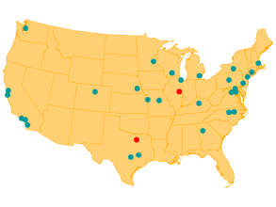
The Berkeley Restricted Data Center
Provides access to dozens of governmental surveys and administrative data sets
Notes:
One of 29 RDCs nationwide, with access to dozens of governmental survey and administrative data sets on population health.

Slide 18
Notes:
A sampling of data sets at the RDC, but there are more e.g., NSDUH, Census data, Bureau of Labor Statistics data.

Slide 19
Find out more and
apply for data access:
https://www.cdc.gov/rdc
Notes:
To get access to these data, you can apply at the CDC website.

Slide 20
The Berkeley Restricted Data Center
Standard RDC access fees: $7,500 per project per year
For UCSF researchers: FREE
To find out more, email pophealth@ucsf.edu or request a CTSI population health consultation:
https://consult.ucsf.edu/phhs
Notes:
What does this have to do with PHDI? Accessing these data on your own would cost $7,500 per project per year. For UCSF researchers, PHDI has acquired institutional membership so RDC access is free. If you need help with an NCHS RDC application, or if you have approval and want to find out more about the free RDC access, feel free to put in a CTSI population health consultation at the link below.

Slide 21
A Guide to Population Health Compute
The Problem: “I have my dataset, I’m ready for analysis… how do I get started?”

Slide 22
Standard Operating Procedure: Compute
Usual approach to finding a compute environment for data analysis:
Contact the MyResearch team…
but your data set is too large for the platform
Contact UCSF IT data center…
but you don’t have the time or money to bring up a dedicated server environment
Consider cloud computing…
but you don’t have secure cloud computing skills

Slide 23
What’s really going on?
The perfect solution for tools-based computation on large data sets does not exist at UCSF…
…yet

Slide 24
The PHDI Solution
PHDI and Academic Research Systems (ARS) aim to solve this by:
Expanding MyResearch to support larger data sets
Proof of concept testing underway!
Ensuring large data computational tools (Stata, R) are available
Have an immediate computing challenge? Email pophealth@ucsf.edu

Slide 25
Conclusion: Contact Us!
PHDI is working to improve access to population health research resources.
We are open to feedback on how to maximize the usefulness of these resources for the UCSF community.
**Please email us if you have data you think could be used by others on campus!

Slide 26
Acknowledgements
PHDI Faculty Leads:
Kirsten Bibbins-Domingo, Vice Dean for Population Health and Health Equity
Claire Brindis, Director of Philip R. Lee Institute for Health Policy Studies
PHDI Team Members:
Robert Thombley, Data architect
Kristin Chu, Director SOMTech
Ariel Deardorff, Data science librarian
Financial Support:
Dan Lowenstein, Executive Vice Chancellor and Provost
Talmadge King, Dean, UCSF School of Medicine

Slide 27
Thank you! Questions?
rita.hamad@ucsf.edu
pophealth@ucsf.edu
https://pophealth.ucsf.edu

